Slide 1
Problem statement draft
Christopher I. Macintosh, PhD, RN
Notes:
Hello everyone
My name is Chris Macintosh. I help teach the capstone courses.
Today we’re talking about the first draft of the problem statement.
[Next slide]

Slide 2
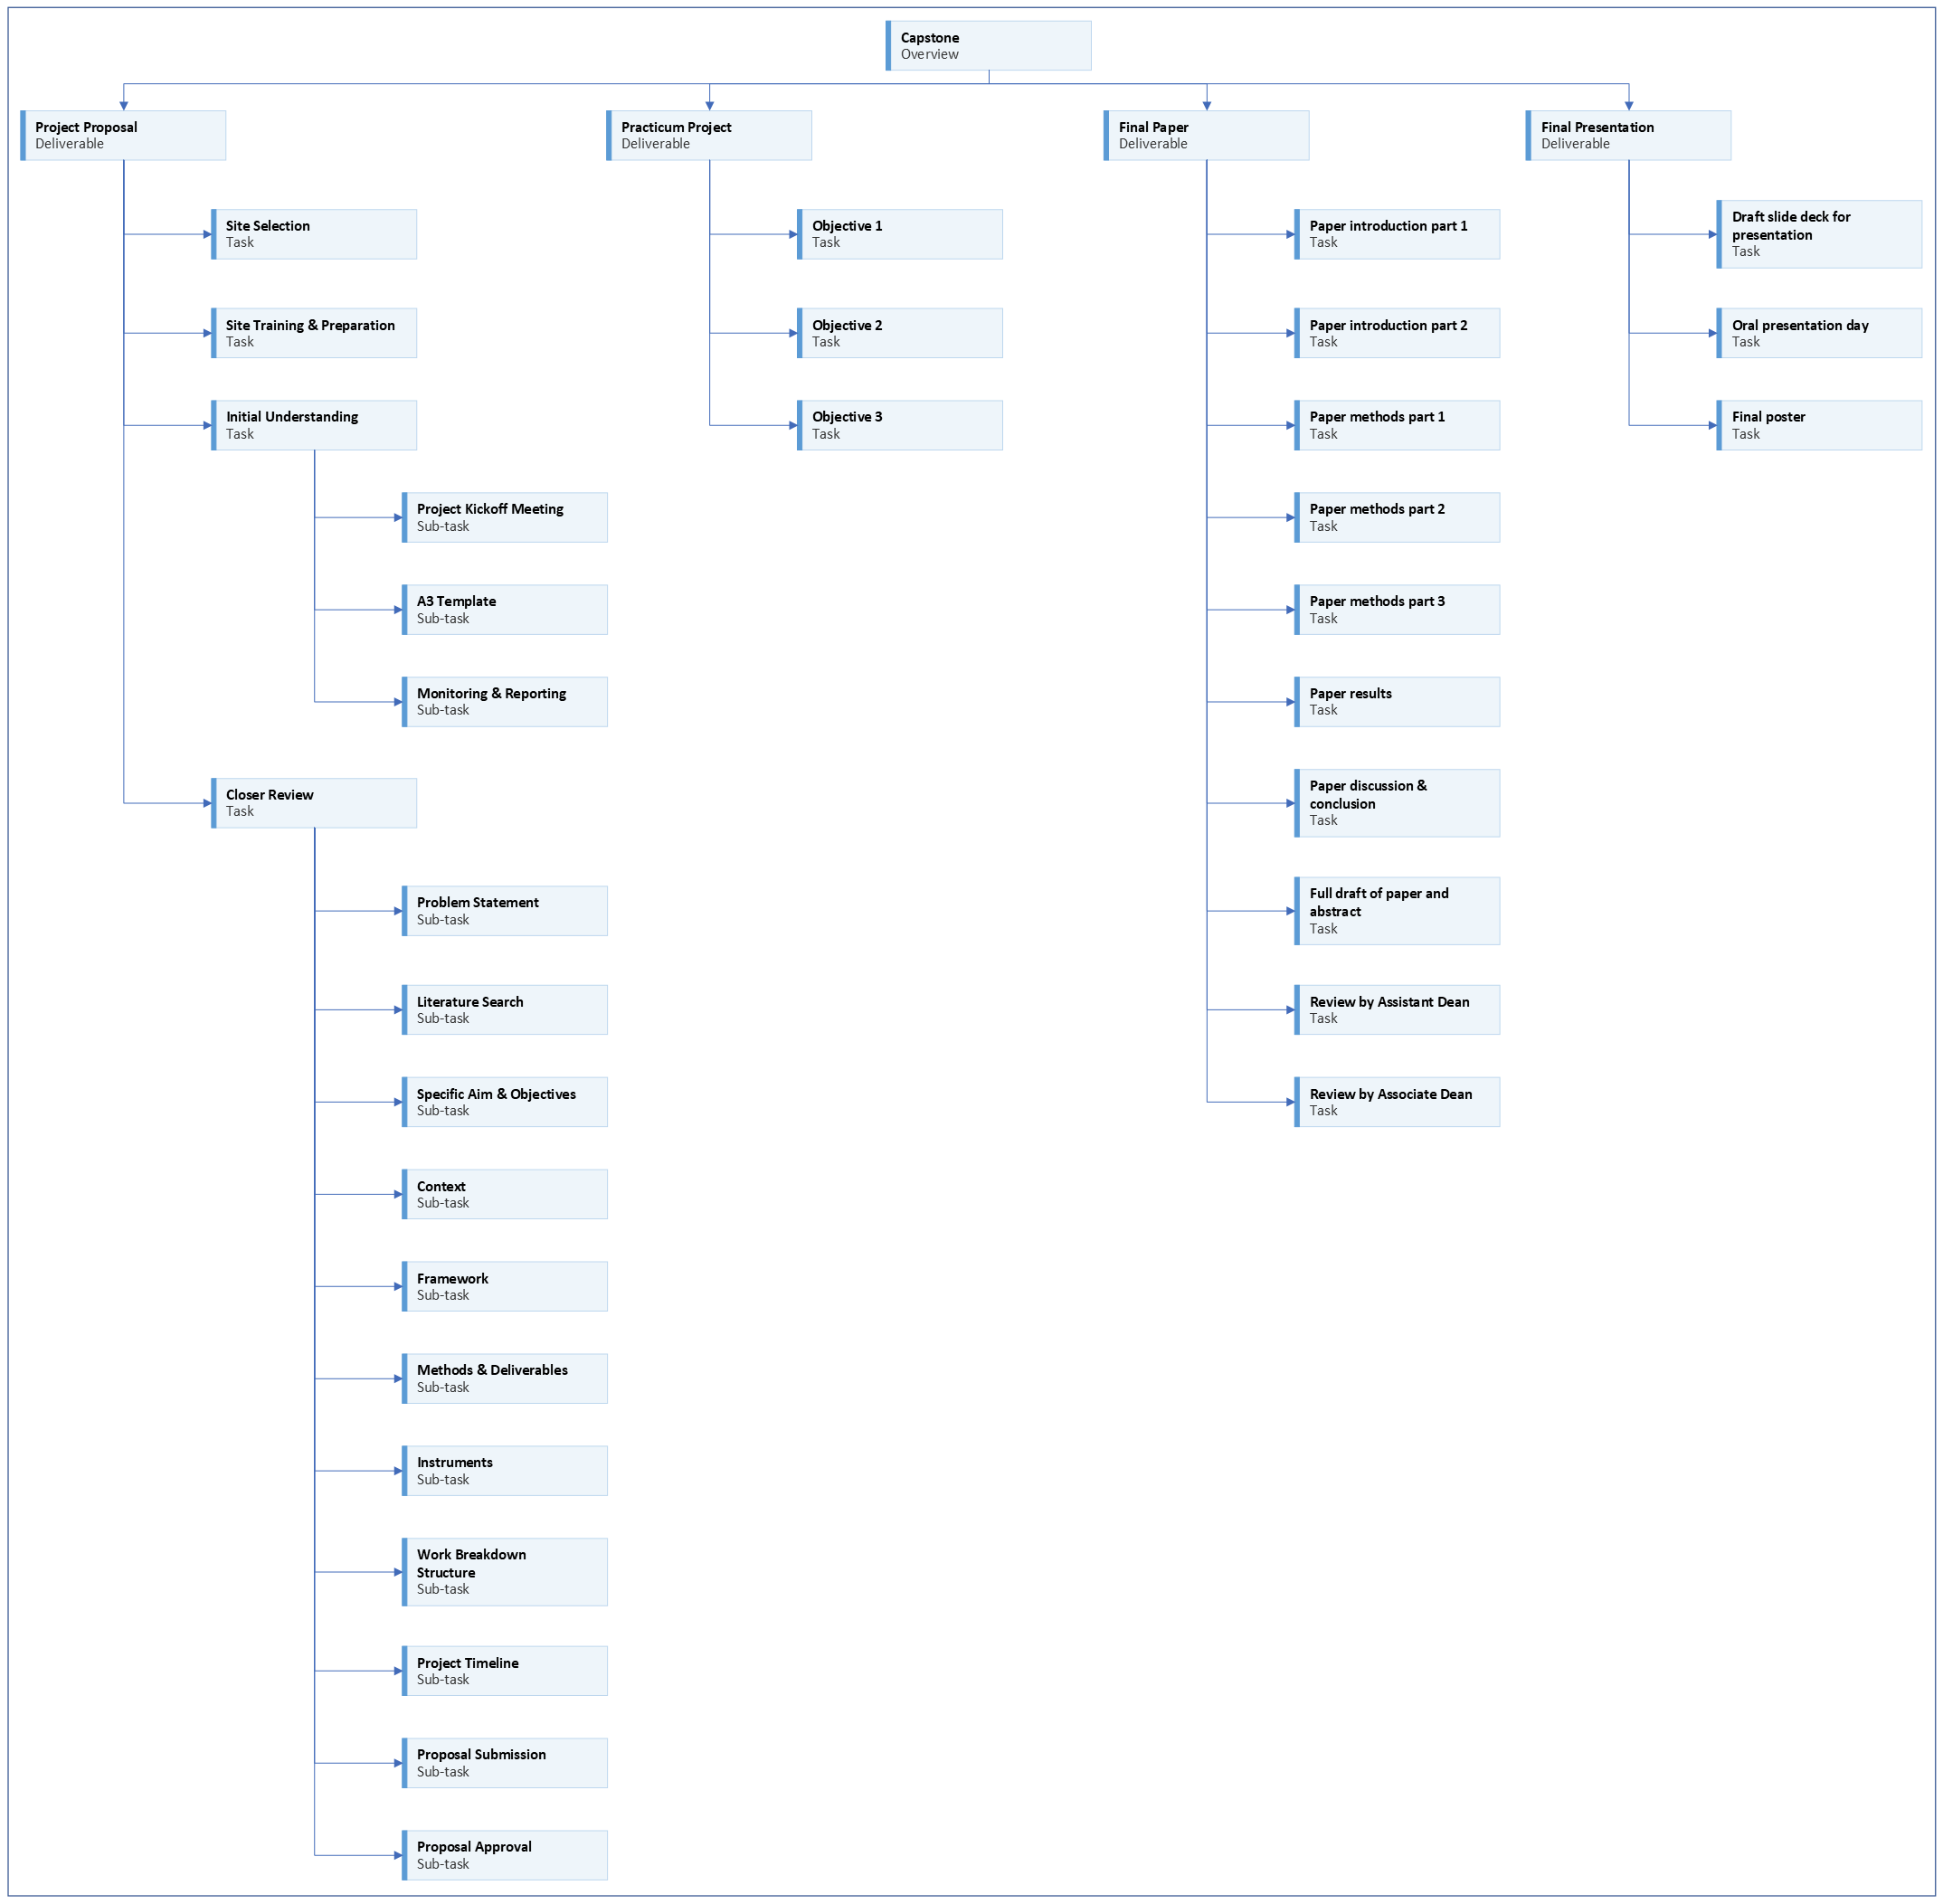
Notes:
[click]
We are working on the project proposal portion of your capstone experience.
[Next slide]

Slide 3
Notes:
[Next slide]

Slide 4
Notes:
By now you should have met with your project preceptor and discussed the basics of your project.
[click]
You’re now ready to write a first draft of your problem statement.
[Next slide]

Slide 5


Purpose
Notes:
The purpose of a problem statement, which is really more of a brief paragraph, is to convince readers and decision-makers in your institution that the problem is serious, and that you have identified the gap(s) needing to be addressed; thus, a problem can be defined as the gap between the existing state and the desired state of a process.
[next slide]

Slide 6









Potential elements
Notes:
Some things to think about when developing a problem statement for your capstone project include:
[click]
Why are you doing this project?
[click]
What is the problem you’re addressing?
[click]
Who is affected?
[click]
When is it a problem?
[click]
Have any trends or patterns been identified?
[click]
Why does it matter?
[click]
Is there an existing standard or protocol that is not being met or followed?
[click]
How does it affect the patient or system?
[click]
What will happen if this problem is not addressed?
[next slide]

Slide 7




Assignment
Notes:
Your assignment is to write a 1 to 2 paragraph problem statement.
[click]
Most of this information will likely come from your project preceptor or other project team members.
[click]
If you’re having trouble writing, just create bullet points that address the questions in the previous slide.
(Getting something down on paper is better than not writing anything.)
[click]
The problem statement mainly focuses on the local problem only.
There is no need to make broader connections yet.
Just describe the problem.
[next slide]

Slide 8




Writing tip
Notes:
Here are some writing tips.
The problem description draft will eventually become the Problem Description section of your project proposal and manuscript.
[click]
The more writing you can do this semester, the easier next semester will be.
[click]
Eventually I will be looking for well-formed paragraphs with topic sentences and supporting statements.
[click]
One way to check for well-formed paragraphs is try reverse outlining.
After you write your paragraph, highlight your topic sentence.
(I usually like to use light-gray to highlight topic sentences.)
Then check to see if the supporting statements in the paragraph support the topic sentence.
If they don’t all seem to support the topic sentence, then you need to write a broader topic sentence or split the paragraph into different paragraphs with separate topics.
[next slide]

Slide 9






Editing tip
https://github.com/cmcntsh/ReviewingWriting
(University of Utah College of Nursing, 2022)
Notes:
Here are some editing tips.
[click]
I do recommend that students use Grammarly.
[click]
ChatGPT is a useful editing tool.
[click]
You can ask ChatGPT to improve individual sentences or paragraphs.
You can find additional information on my Reviewing Writing GitHub page.
[click]
It goes without saying that you alone are responsible for the content of your own paper.
Never use anything without reviewing it first.
There is a difference between getting help revising content you create and having another source create content for you.
[click]
Professional editing services can cost between $50 to $120 per hour on average.
It can save you time and money to use appropriate tools available to you.
[next slide]

Slide 10

More to come . . .
Notes:
That’s all we’ll do in this video.
There is more to come.
[next slide]

Slide 11
References
University of Utah College of Nursing. (2022). Master's of science nursing program policy and progression manual 2022-2023. University of Utah College of Nursing. https://nursing.utah.edu/documents/masters-policy-and-progression20222023final
Notes:
This was the only reference.

